Slide 1
The Effect of Increased Extreme Rainfall Events on the Iowa Nutrient Reduction Strategy
Kait Sagan
Manhui Zhu
Mercy Neal

Slide 2
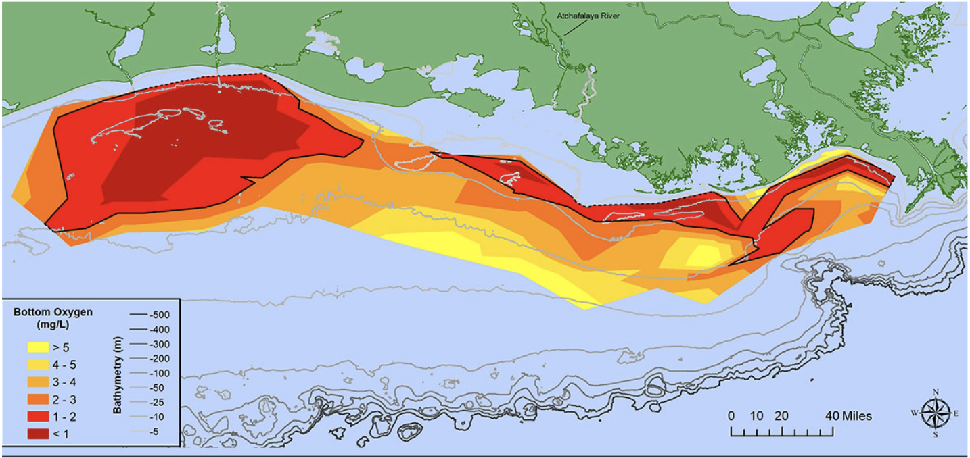
Mississippi River and Gulf of Mexico (Dead Zone)
The Mississippi River drains water and pollutant from 31 states to the Gulf of Mexico.
Its watershed is the most productive agricultural land in the country.
Excess nutrients transport to the river via rainfall runoff.
Hypoxia in the discharge area of river basin, formed a dead zone in the Gulf
Notes:
Hypoxia: dissolved oxygen less than 2 milligrams in the river. Two conditions are necessary: stratification of water column, presence of organic matter to consume oxygen.
Figure: At 6,334 square miles, the 2021 hypoxic zone in the Gulf of Mexico is the 16th largest ever measured in the 35-year record, measured from July 25 to August 1. Red area denotes 2 milligrams per liter of oxygen or lower, the level which is considered hypoxic, at the bottom of the seafloor.

Slide 3
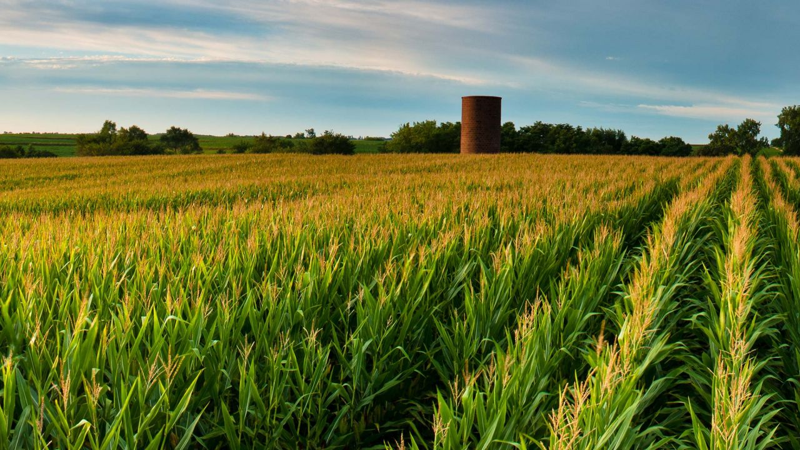
How precipitation influence Nitrogen runoff?
Over 60% of land area of the Mississippi Basin has experienced increasing extreme precipitation since 2000.
This area yields over 80% of nitrogen leaching loss across the region.
Extreme precipitation events contribute about 1/3 of total N yields in the Gulf.
Iowa Nutrient Reduction Strategy aims to decrease nutrient runoff into the Mississippi by 45%.

Slide 4
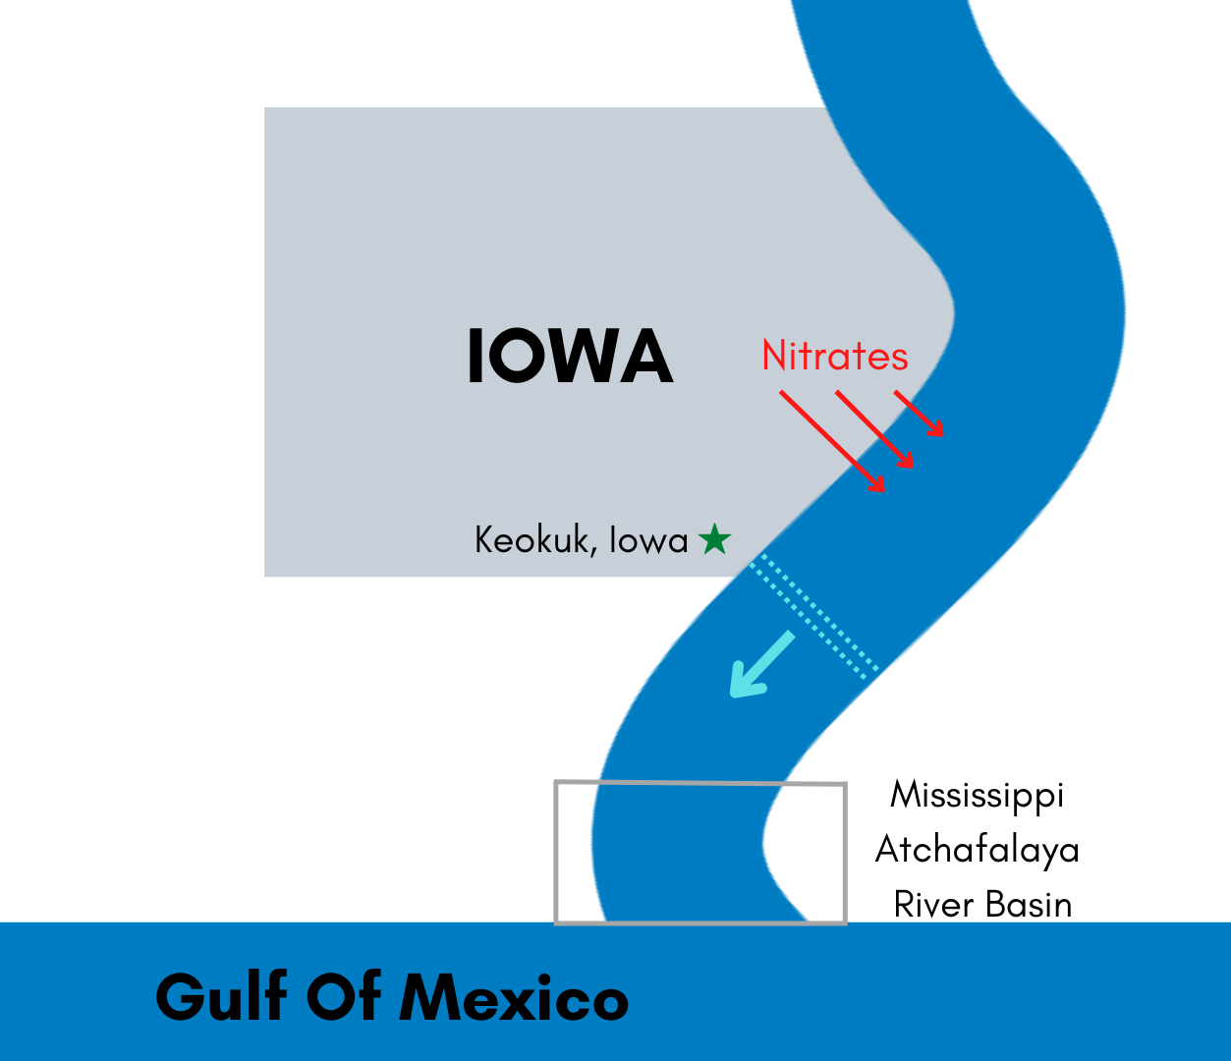
What comparative effect do climate change and Iowa’s Nutrient Reduction Strategy (2013) have on the mass of nitrates that reach the Mississippi Atchafalaya River Basin (MARB)?

Slide 5
Assumptions Required:
Physical Assumptions
Assume that the deposition of fertilizer is constant, and that concentrations of fertilizer in the Mississippi are not near saturation. Assume concentration of fertilizer from upstream of Iowa does not affect the deposition rate of fertilizer in and downstream of Iowa.
Assume complete lateral mixing of fertilizer within the CV.
Assume no partitioning of fertilizer to the air, or other factors not considered in the loss rate.
Assume a constant volume of fertilizer is emitted year-round and that an increase in extreme weather events directly correlates with an increase in fertilizer runoff.
Assume that the only way climate change is affecting fertilizer runoff is increased runoff due to extreme weather, and that changes in temperature do not impact the rate deposition of the fertilizer.
Assume Q=13,500 m^3/s
Assume nitrate loadings in the Mississippi Atchafalaya River Basin (MARB) are equal to those in the Gulf of Mexico which cause hypoxic zones.
Assume Iowa contributes 31.5% of nitrate loading in the MARB
Assume Distance along Mississippi River from Keokuk, IA to Morgan City, LA (MARB) is 1650 km
Systemic Assumptions:
Assume Climate change impacts extreme event increase one time
Assume contributions of all other non-Iowa sources are constant.
Assume other factors influencing runoff not considered by the Nutrient Reduction strategy, such as wetland cover, remain constant.

Slide 6
Equations
Iowa’s contribution to nitrate loading in MARB
Other contributions of nitrate loading in MARB
Iowa’s initial loading into the Mississippi River
Iowa’s contribution to nitrate load in MARB upon achieving the Iowa Nutrient Reduction Strategy goal
Estimated increase in nitrate runoff from Iowa due to climate change (15.5%)
Iowa’s contribution to nitrate load in MARB upon achieving the Iowa Nutrient Reduction Strategy goal, but taking into account runoff increases due to climate change
Notes:
Equations 3,4,6 use PFR problem set up- eq3 is finding the initial concentration of nitrates in mississippi river and eq 4&6 are finding C final
Equation 1 is found using inferences from data (avg annual flux of nitrogen into MARB, 61% of that flux is nitrate, Iowa contributes 31.5% of this loading (assumption))
Equation 2 found after eq1
Equation 5: 8.6 extreme precip days account for ⅓ of nitrate yield and des moines iowas now experiencing 4 more days of extreme rain each year- find percent yield from one extreme rain event then multiply by 4

Slide 7
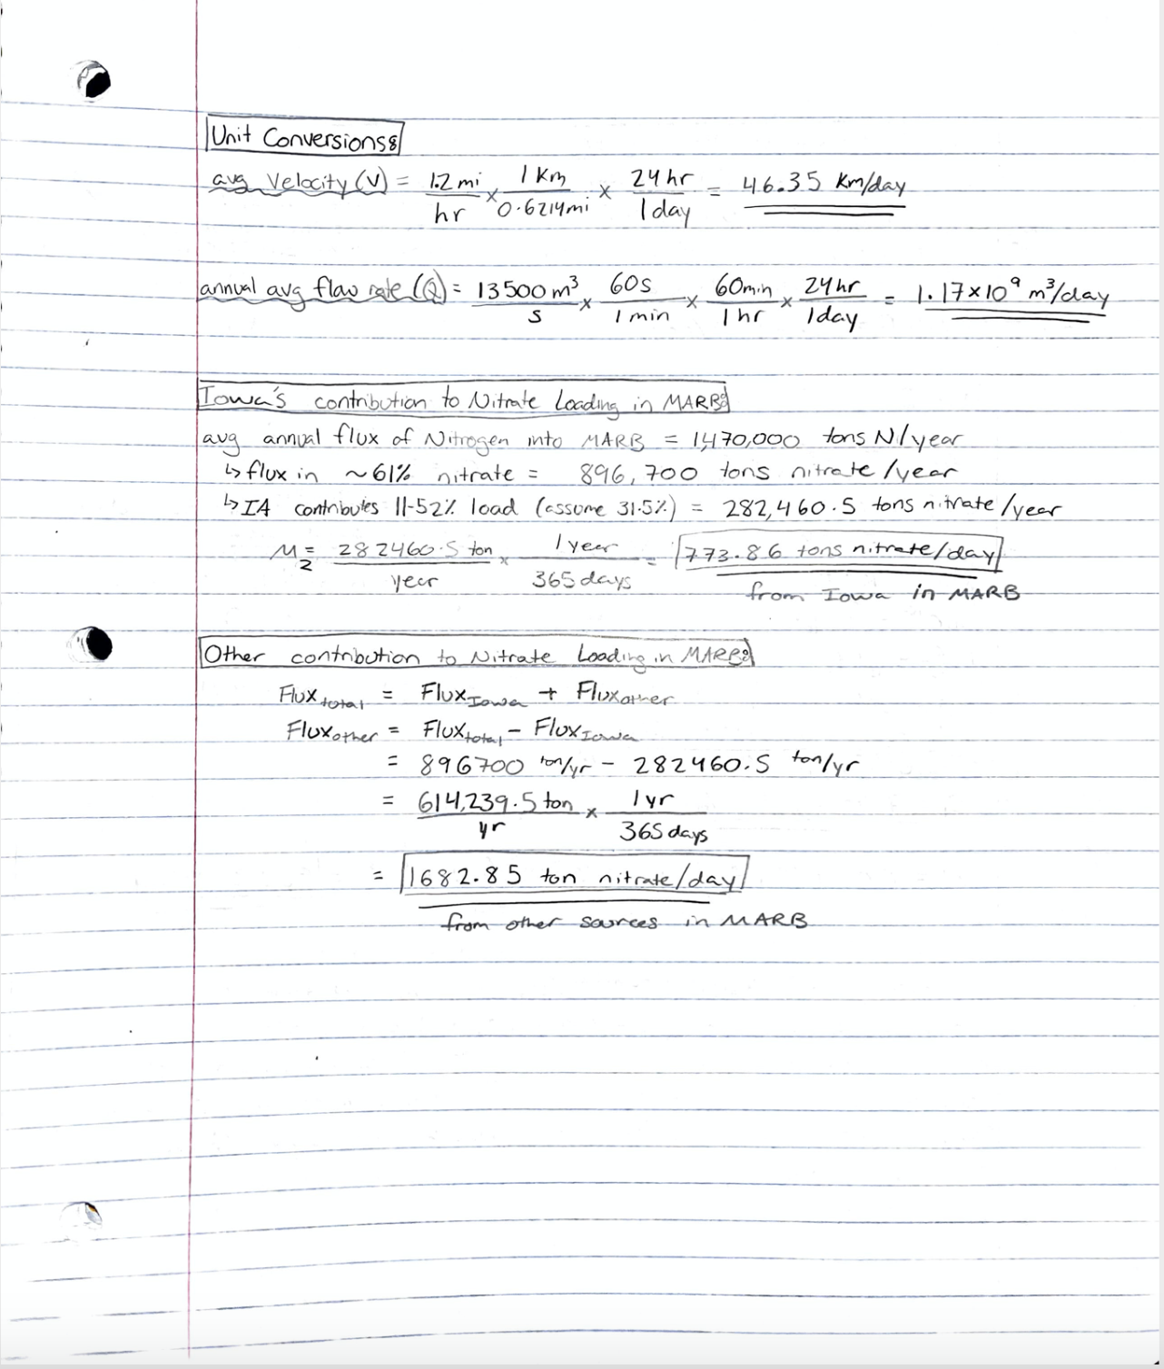
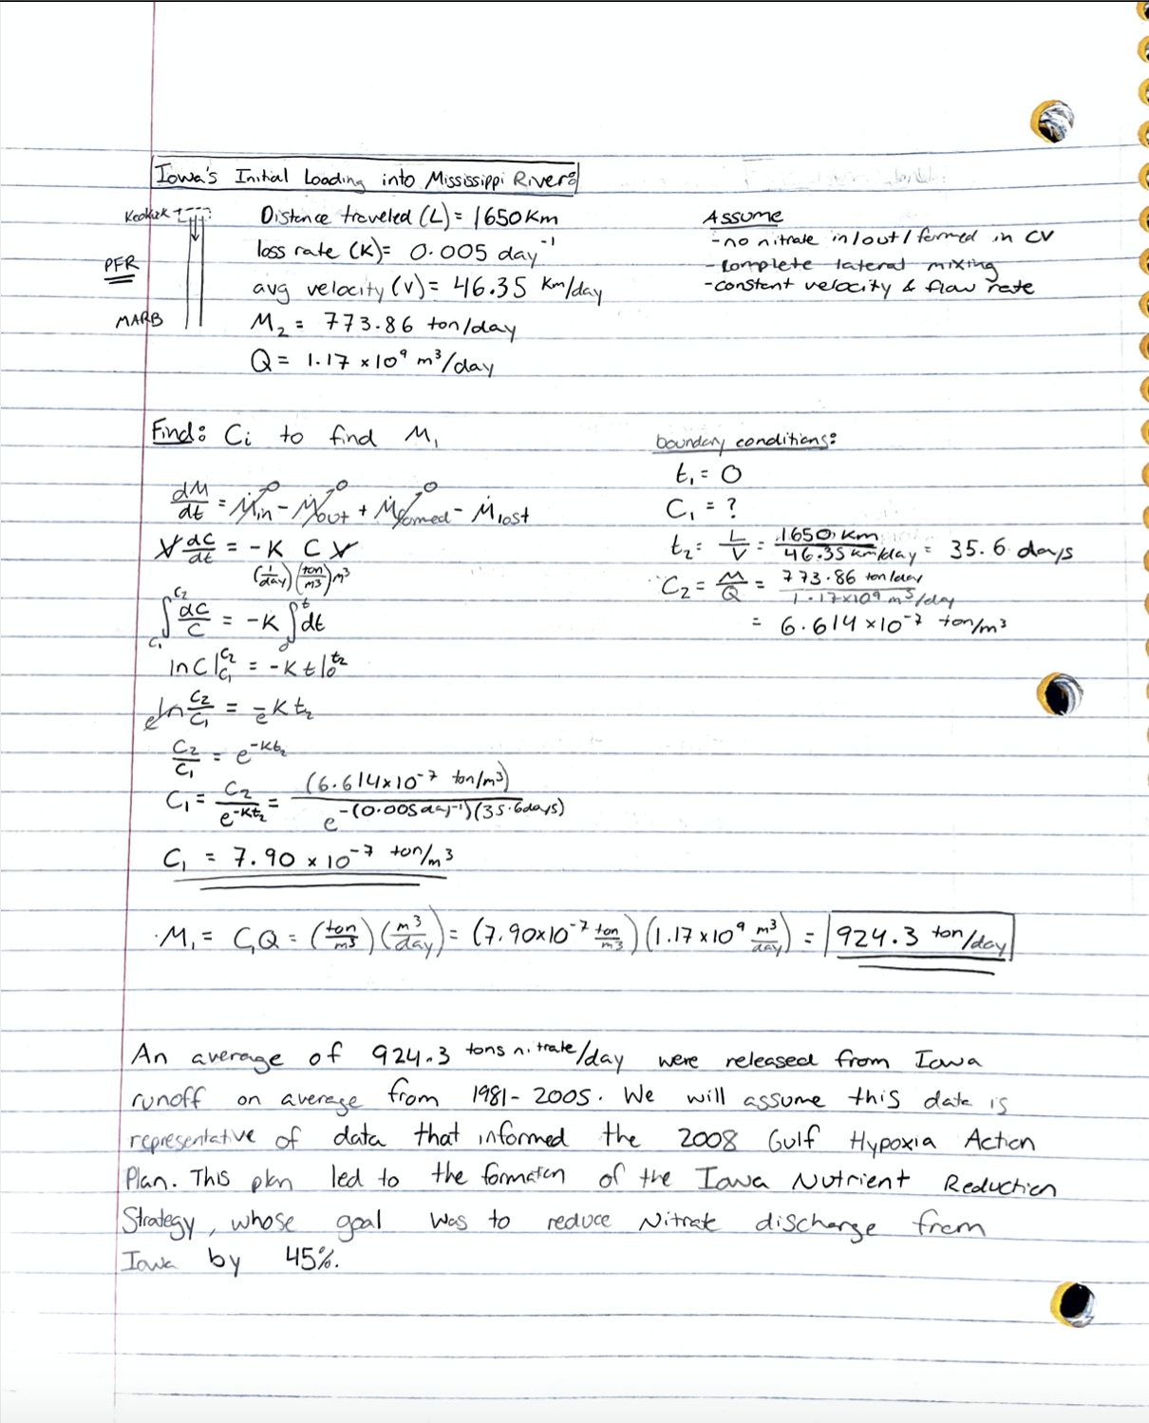

Slide 8
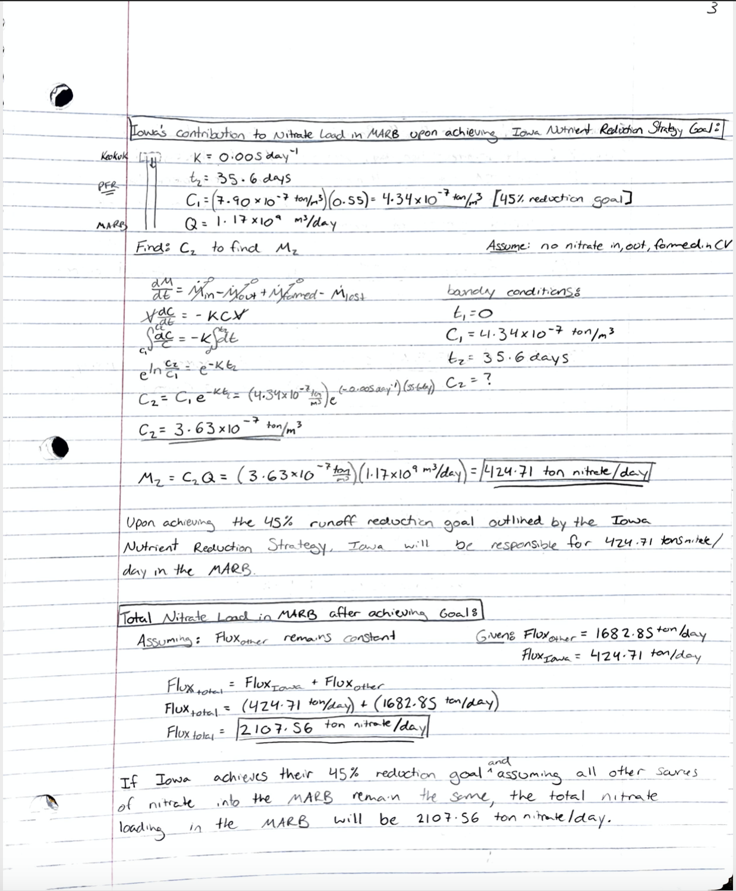
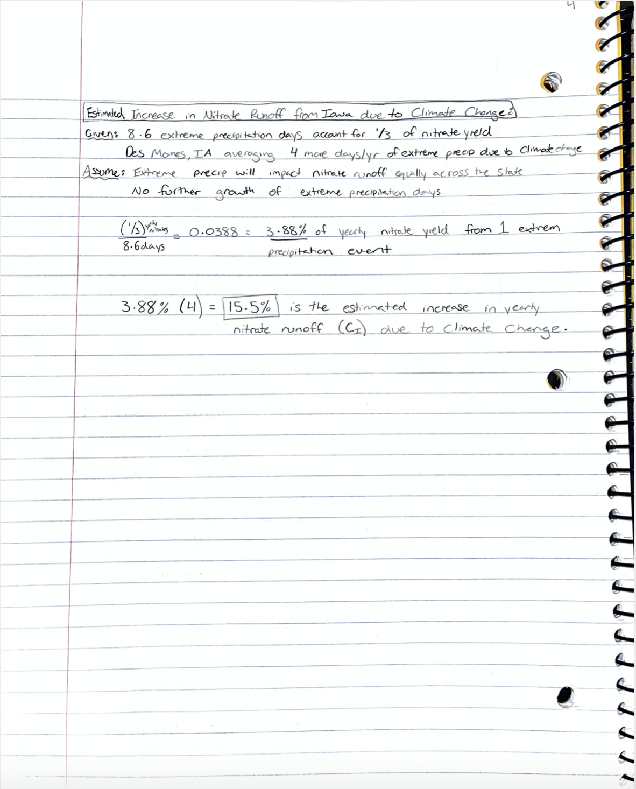

Slide 9
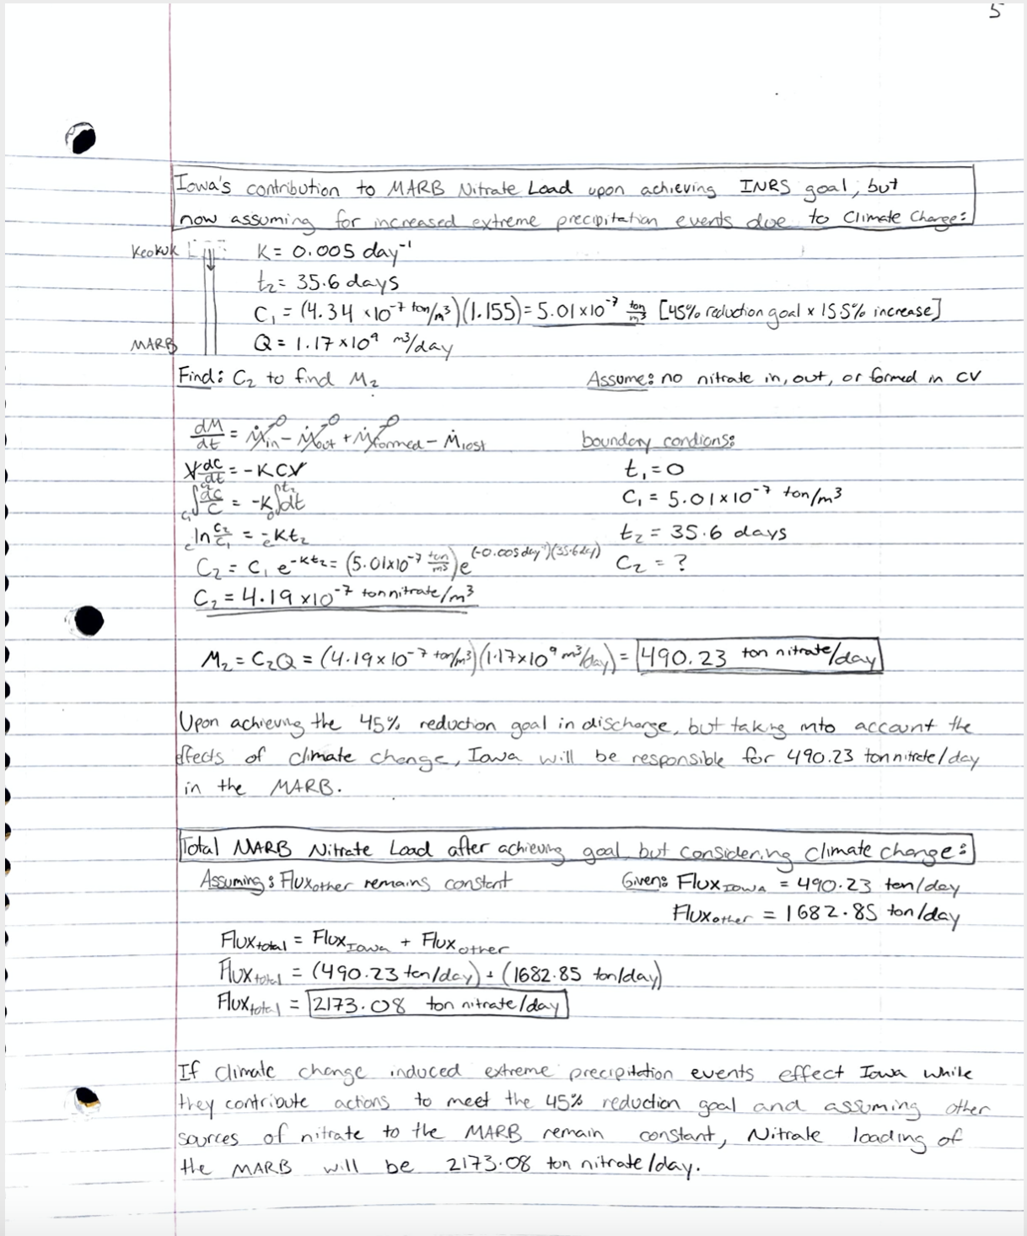

Slide 10
490.23 Tons/day
The amount of nitrates from Iowa that would enter the Mississippi Atchafalaya River Basin after adjustment both for increased severe weather events and for Iowa’s Nutrient Reduction Strategy.

Slide 11
Analysis of Assumptions:
Overestimate Likely
Underestimate Likely
Notes
1
Mathematical Assumptions
Complete Lateral Mixing?
Control Volume moving at constant velocity
Assume direct correlation between increased rainfall events and increased nitrates.
2
“Streamlining” Assumptions
Will upstream nitrates affect deposition?
Will nitrate increases and decreases from other regions within Iowa affect deposition?
Temperature/River Flow Constant?
3
Real-World Future Prediction
?
?
Will Climate Change remain constant?
Will Iowa meet their goal?
Will all other policies remain constant?
Effectively, our model provides useful information about the comparative magnitudes of these effects, but omits enough information that it likely does not provide highly accurate concentrations. Many of the assumptions we made were also predictions about the future, which are unlikely to be accurate.

